Slide 1

Introduction to Machine Learning

Slide 2

Hello! Instructor Introduction
Instructor: Anshu Pandey
Microsoft Certified Trainer
Data Scientist
Microsoft Certified Azure AI Associate & Data Scientist
BootUP Venutres
A Data Scientist and AI Architect having 8+ years of experience of working with organizations to develop Data Science and AI Applications and helping them with AI Transformation.

Slide 3

Artificial Intelligence

Slide 4
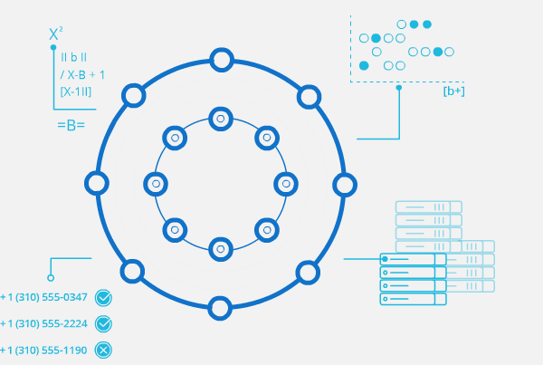
What is Artificial Intelligence?
“The capability of a machine to imitate intelligent human behavior“
Notes:
the theory and development of computer systems able to perform tasks normally requiring human intelligence, such as visual perception, speech recognition, decision-making, and translation between languages

Slide 5
What is Artificial Intelligence?
Machine
or Computers
Artificial Intelligence
+
Intelligence
=

Slide 6
What is Artificial Intelligence?
Input
Data
Sensors
Images
Artificial Intelligence
Output
Action
Movement
Text

Slide 7
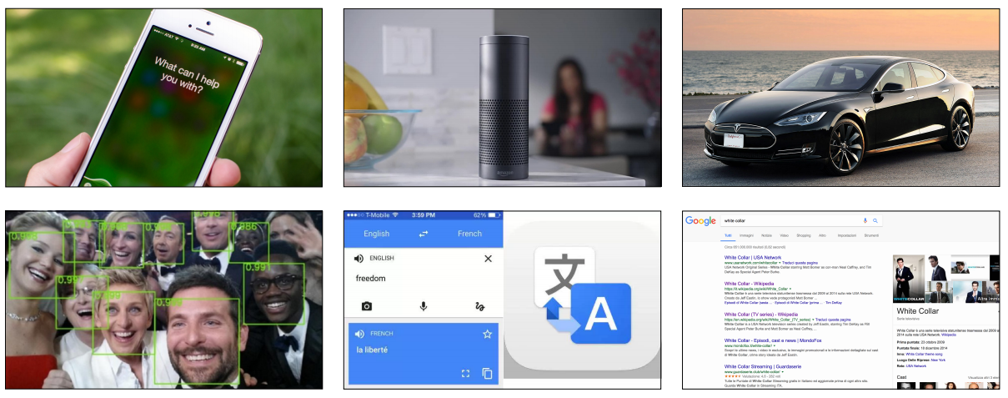
Artificial Intelligence in everyday products

Slide 8
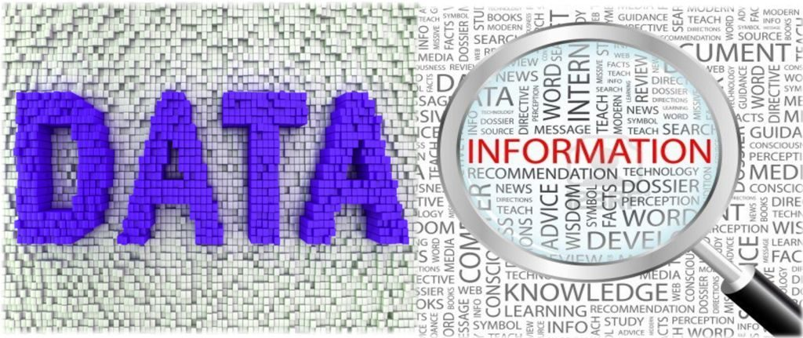
What is Data?
Structured
Business Data, Excel, CSV
Unstructured
Text, Images and Speech

Slide 9
Early 1950 Optimism began
Artificial Intelligence
1980’s Machine Learning begins to flourish
Machine Learning
2010 Deep Learning breakthroughs
Deep Learning

Slide 10
AI Landscape
Artificial Intelligence Collection of algorithms used to build intelligence

Slide 11
AI Landscape
Artificial Intelligence Collection of algorithms used to build intelligence
Machine Learning algorithms which use DATA to build intelligence

Slide 12
AI Landscape
Artificial Intelligence Collection of algorithms used to build intelligence
Machine Learning algorithms which use DATA to build intelligence
Deep Learning AUTOMATED FEATURE ENGINEERING

Slide 13
AI Landscape
Artificial Intelligence Collection of algorithms used to build intelligence
Machine Learning algorithms which use DATA to build intelligence
Deep Learning AUTOMATED FEATURE ENGINEERING
Data Analytics
Statistics, Visualization
Structured Data

Slide 14
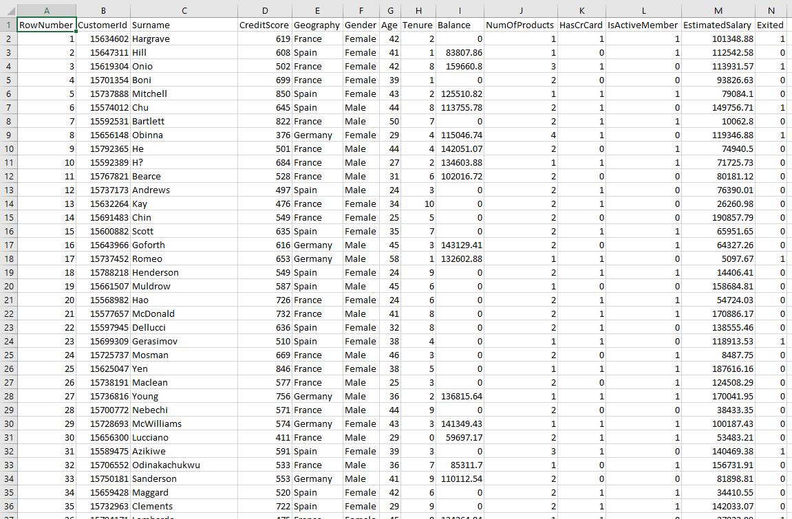

Slide 15
AI Landscape
Artificial Intelligence Collection of algorithms used to build intelligence
Machine Learning algorithms which use DATA to build intelligence
Deep Learning AUTOMATED FEATURE ENGINEERING
Data Analytics
Statistics, Visualization
Structured Data
DATA
SCIENCE

Slide 16
AI Landscape
Artificial Intelligence Collection of algorithms used to build intelligence
Machine Learning algorithms which use DATA to build intelligence
Deep Learning AUTOMATED FEATURE ENGINEERING
Data Analytics
Statistics, Visualization
Structured Data
Image Processing
Images,Video(w/o audio)
Unstructured Data
DATA
SCIENCE

Slide 17
AI Landscape
Artificial Intelligence Collection of algorithms used to build intelligence
Machine Learning algorithms which use DATA to build intelligence
Deep Learning AUTOMATED FEATURE ENGINEERING
Data Analytics
Statistics, Visualization
Structured Data
Image Processing
Images,Video(w/o audio)
Unstructured Data
DATA
SCIENCE
COMPUTER VISION

Slide 18
AI Landscape
Text/Speech
Processing
Text/Audio
Unstructured Data
Artificial Intelligence Collection of algorithms used to build intelligence
Machine Learning algorithms which use DATA to build intelligence
Deep Learning AUTOMATED FEATURE ENGINEERING
Data Analytics
Statistics, Visualization
Structured Data
Image Processing
Images,Video(w/o audio)
Unstructured Data
DATA
SCIENCE
COMPUTER VISION

Slide 19
AI Landscape
Text/Speech
Processing
Text/Audio
Unstructured Data
Artificial Intelligence Collection of algorithms used to build intelligence
Machine Learning algorithms which use DATA to build intelligence
NATURAL
LANGUAGE
PROCESSING - NLP
Deep Learning AUTOMATED FEATURE ENGINEERING
Data Analytics
Statistics, Visualization
Structured Data
Image Processing
Images,Video(w/o audio)
Unstructured Data
DATA
SCIENCE
COMPUTER VISION

Slide 20
AI Landscape
Text/Speech
Processing
Text/Audio
Unstructured Data
Artificial Intelligence Collection of algorithms used to build intelligence
Machine Learning algorithms which use DATA to build intelligence
NATURAL
LANGUAGE
PROCESSING - NLP
Deep Learning AUTOMATED FEATURE ENGINEERING
Data Analytics
Statistics, Visualization
Structured Data
Image Processing
Images,Video(w/o audio)
Unstructured Data
DATA
SCIENCE
COMPUTER VISION

Slide 21
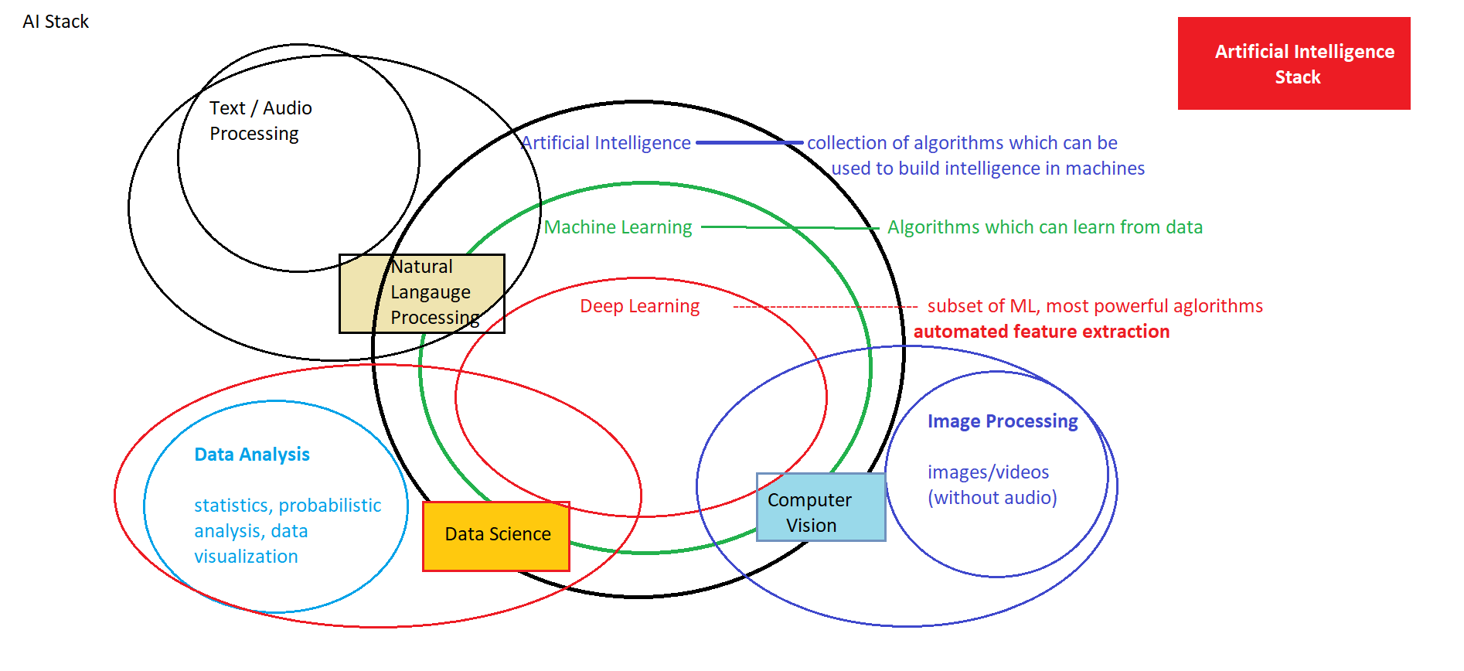

Slide 22
Artificial Intelligence
Data Science
Computer Vision
Natural Language Processing

Slide 23
Artificial Intelligence
Data Science
Predicting Stock prices, housing prices or any other item prices based on historical data
Predicting whether customer will buy a product or not, customer will churn or not
Classifying the customers in different known groups
Risk predictions for financial transactions.
Fraud Detection from transactional data
Segmentation of customers, stocks and server logs
Predicting patient readmission into hospital
Detecting anomalies in access management, data control
Building product recommendation systems
Computer Vision
Natural Language Processing

Slide 24
Artificial Intelligence
Data Science
Face Recognition, Emotion Recognition
Optical Character Recognition
Document verification, authentication
Object Detection and Classification from images
Identifying forgery in the images
Vehicle number plate, type recognition
Self Driving Cars – lane detection, traffic sign classification, Behavioural Cloning
Motion Detection from videos
Image restoration, colouring and pattern transfer
Action Prediction
Computer Vision
Natural Language Processing

Slide 25
Artificial Intelligence
Data Science
Text/document classification
Social Media Text mining and Analysis
Speech to Text and Text to Speech conversion
Caption generation
Machine Translation
Sentiment analysis from text
Chatbots
Speaker recognition
Personal Assistant, Sentence Correction
Text Generation, Similarity Matching, Topic Modelling
Computer Vision
Natural Language Processing

Slide 26
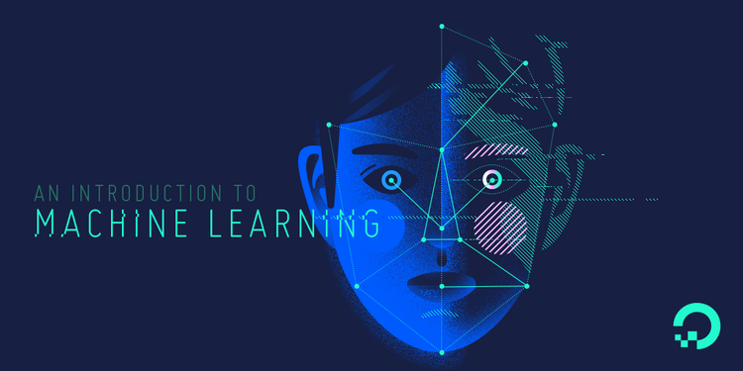

Slide 27

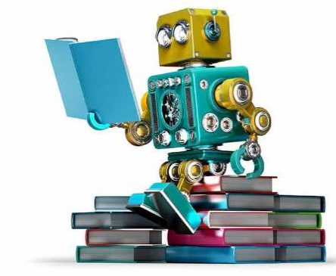
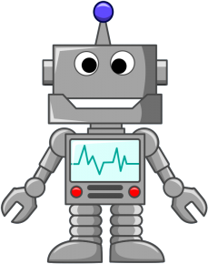

Slide 28
Machine learning is a field of computer science that gives computers the ability to learn without being explicitly programmed.
—Arthur Samuel, 1959

Slide 29
Applications of Machine Learning
Financial Predictions, Fraud Detections
Loan Approval
Data Mining – Web Click Data, Medical Records, Diagnosis
Predictive Maintenance
Ad plus user information
Computer Vision – Face Recognition, Self Driving Cars, OCR
Churn Prediction, Customer Segmentation, Sales Forecasting
Voice recognition, Chatbots, Sentiment Analysis, Machine Translation

Slide 30
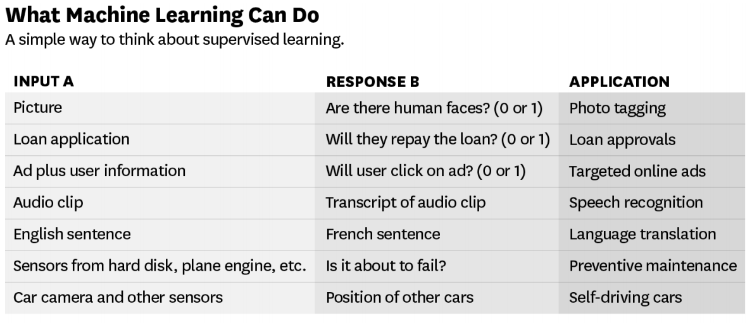
Source – ANDREW NG

Slide 31
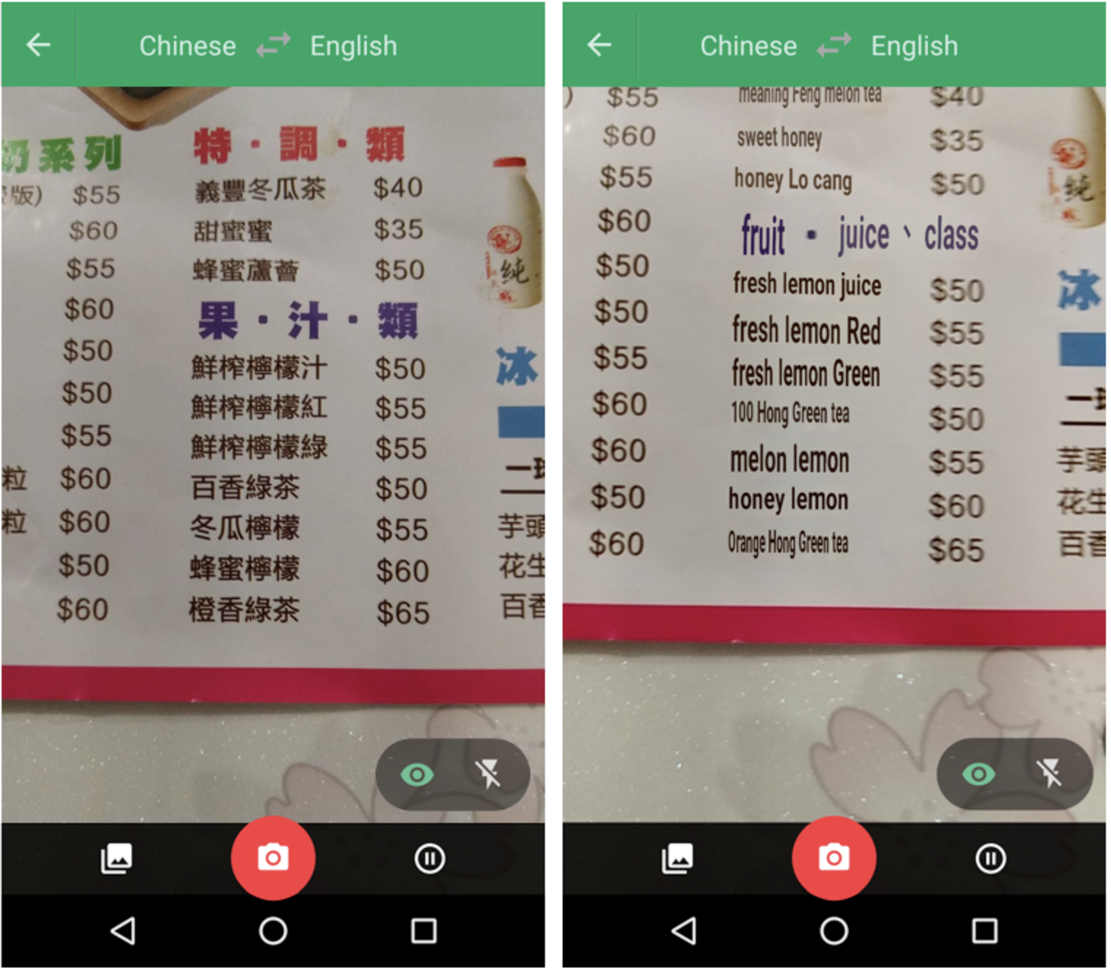
!!
Point your camera at the menu during your next trip to Taiwan and the restaurant’s selections will magically appear in English via the Google Translate app.
Google Translate overlaying English translations on a drink menu in real time using convolutional neural networks.

Slide 32
Manufacturing | Retail | Financial Services
Predictive maintenance or condition monitoring Warranty reserve estimation Propensity to buy Demand forecasting Process optimization Telematics | Predictive inventory planning Recommendation engines Upsell and cross-channel marketing Market segmentation and targeting Customer ROI and lifetime value | Risk Analytics and Regulations Customer Segmentation Cross-selling and up-selling Sales and marketing campaign management Credit worthiness evaluation
Travel and Hospitability | Health Care and Life Sciences | Energy, Feedstock and Utility
Aircraft scheduling Dynamic pricing Social media — consumer feedback and interaction analysis Customer complaint resolution Traffic patterns and congestion management | Alerts and diagnostics from real-time patient data Disease identification and risk stratification Patient triage optimization Proactive health management Healthcare provider sentiment analysis | Power usage analytics Seismic data processing Carbon emissions and trading Customer-specific pricing Smart grid management Energy demand and supply optimization

Slide 33

Netradyne
Netradyne’s Driveri, a powerful camera that analyses driving patterns and can help determine the cause of an accident. The soap-bar-sized device is attached to a vehicle’s rear-view mirror and rests on the inside of the windscreen, pointing towards the road.

Slide 34
Programming Languages -
Python | R

Slide 35
Machine Learning Cloud Platforms -
Microsoft Azure ML Studio
https://azure.microsoft.com/en-us/services/machine-learning-studio/
Amazon Machine Learning
https://aws.amazon.com/aml/
SAP Leonardo Machine Learning
https://www.sap.com/india/products/leonardo/machine-learning.html
Google ML Platform
https://cloud.google.com/products/machine-learning/
IBM Machine Learning
https://www.ibm.com/analytics/data-science/machine-learning

Slide 36
What to learn in machine Learning?
Programming and
Tools
30%
Python/R, spark etc.
The Math behind
Machine Learning
70%
Probabilistic Theory, Statistics and Linear Algebra

Slide 37
What to learn in Machine Learning?
R/Python for Machine Learning
Packages for Machine Learning – Tensorflow, keras etc.
Handling Big Data
Practice, practice & practice
Optimization, boosting Techniques
Statistics for Data Science
Math behind Machine Learning Algorithms

Slide 38
Machine Learning Techniques

Slide 39
Discovering patterns in unlabeled data.
Cluster similar documents based on the text content.
Learning based on feedback or reward.
Learn to play chess by winning or losing.
Learning with a labeled training set.
Email spam detector with training set of already labeled emails.
Supervised Learning
Unsupervised Learning
Reinforcement Learning

Slide 40




Supervised Learning
We know what we are trying to predict. We use some examples that we (and the model) know the answer to, to “train” our model. It can then generate predictions to examples we don’t know the answer to.
Examples: Predict the price a house will sell at. Identify the gender of someone based on a photograph.

Slide 41


Unsupervised Learning
We don’t know what we are trying to predict. We are trying to identify some naturally occurring patterns in the data which may be informative.
Examples: Try to identify “clusters” of customers based on data we have on them

Slide 42
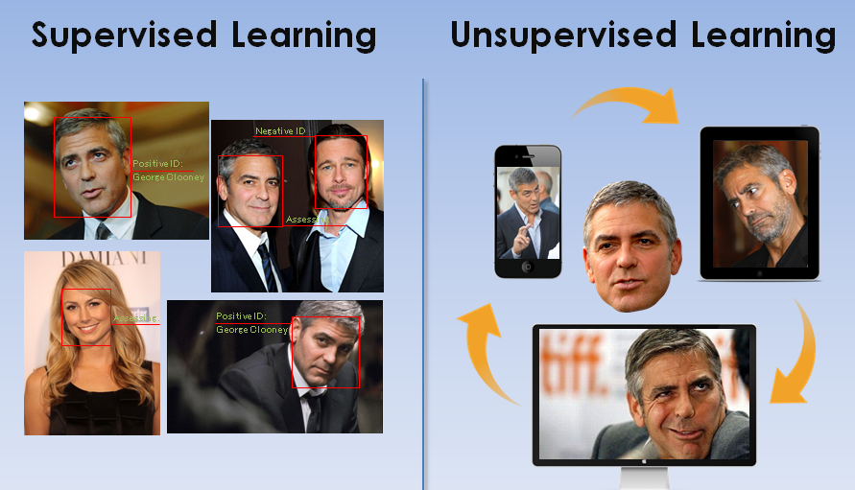

Slide 43
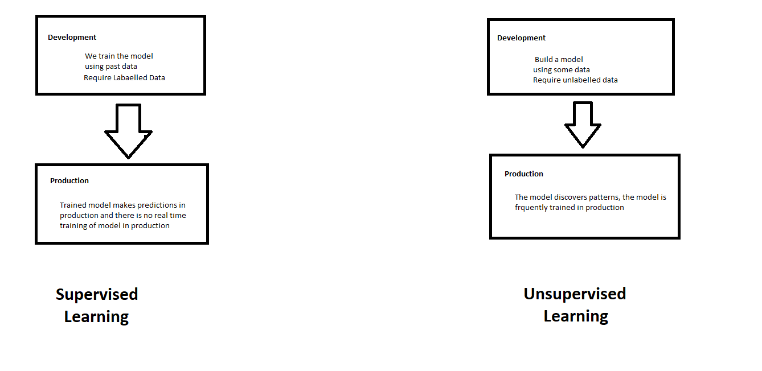
Supervised and Unsupervised Learning

Slide 44
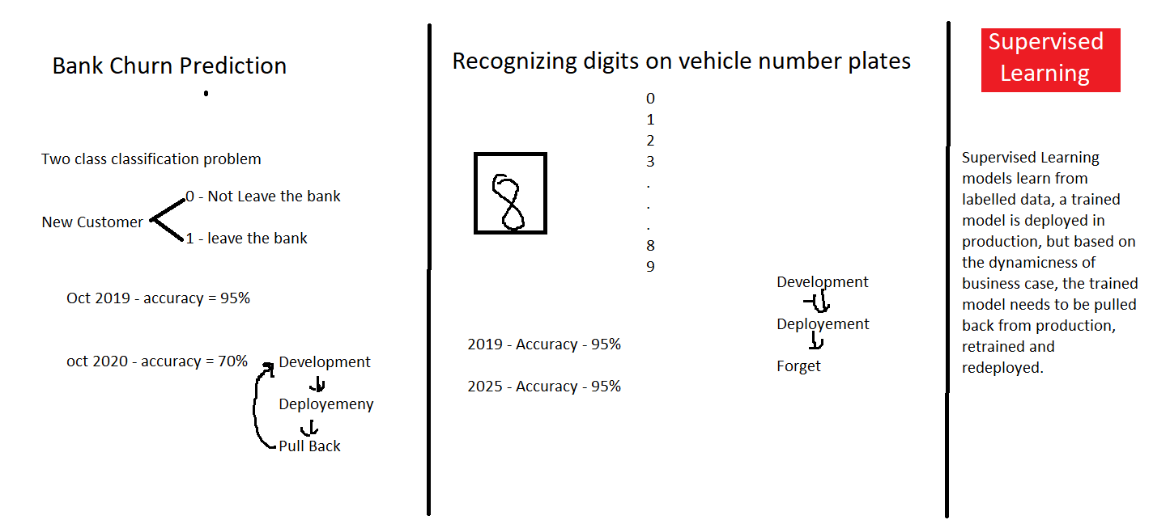

Slide 45
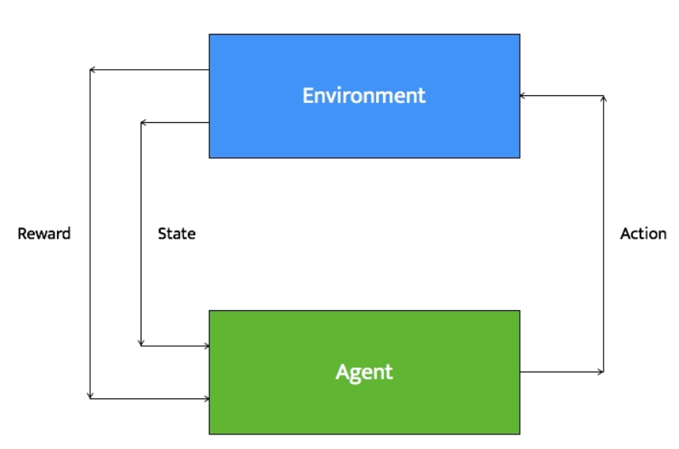
Reinforcement Learning
Reinforcement learning systems can do multiple things simultaneously -- learn by performing a trial and error search, learn the model of the environment it is in, and then use that model to plan the next steps.
Example: Let's consider a robot whose job is to explore a new building. It has to make sure it has enough power left to come back to the base station. This robot has to decide if it should make decisions by considering the trade off between the amount of information collected and the ability to reach back to base station safely.

Slide 46
Types of Problems in Machine Learning

Slide 47
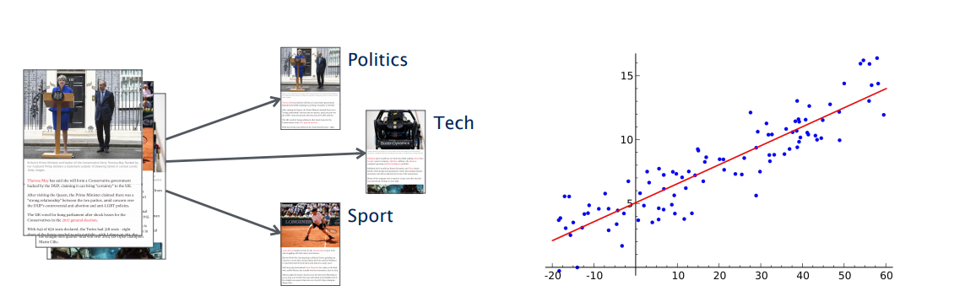
Types of Problems in Supervised Machine Learning -
Classification
(discrete set of possible outcomes)
Regression
(possible outcome can by any numerical value with in a particular continuous range)

Slide 48
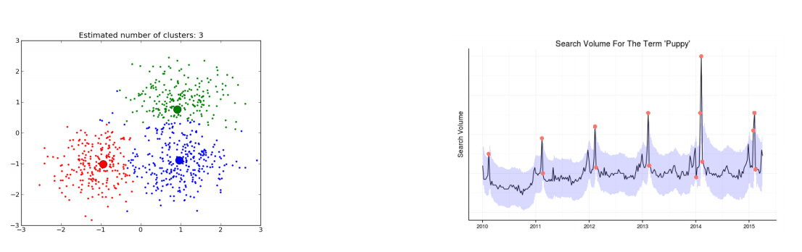
Types of Problems in Unsupervised Machine Learning -
Clustering
(categorization of samples based on similarity in features)
Anomaly Detection
(detecting an anomaly in a general pattern)

Slide 49

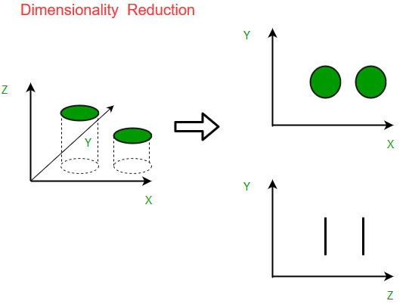
Types of Problems in Unsupervised Machine Learning -
Recommendation Systems
(profiling of users and items and recommending relevant items to user)
Dimensionality Reduction
(Reducing dimensionality/size of data)

Slide 50
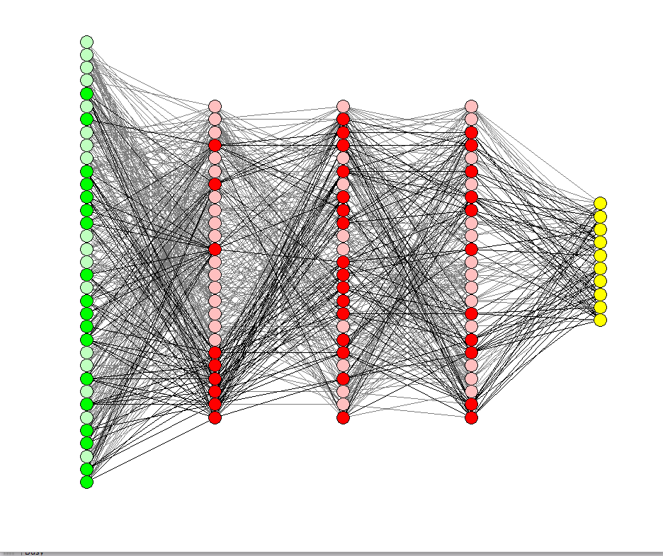
Deep Learning

Slide 51
Deep Learning
Deep Learning is part of the machine learning field of learning representations of data. Exceptional effective at learning patterns.

Slide 52
Deep Learning in one slide
What is it:
Extract useful patterns from data.
How:
Neural network + optimization
How (Practical):
Python + TensorFlow & friends
Hard Part:
Good Questions + Good Data
Why now:
Data, hardware, community, tools, investment
Where do we stand?
Most big questions of intelligence have not been answered nor properly formulated
Exciting progress:
Face recognition
Image classification
Speech recognition
Text to speech generation
Handwriting transcription
Machine translation
Medical diagnosis
Cars: drivable area, lane keeping
Digital assistants
Ads, search, social recommendations
Game playing with deep RL

Slide 53
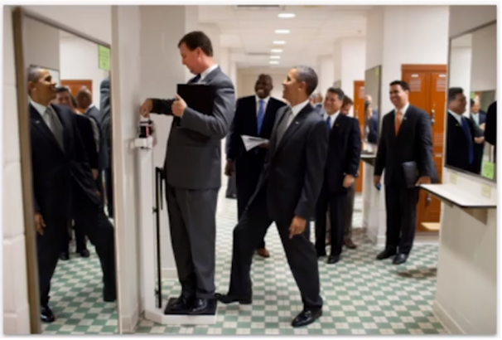
What we can’t do with Deep Learning?
Mirrors
Sparse information
3D Structure
Physics
What’s on peoples’ minds?
What happens next?
Humor

Slide 54
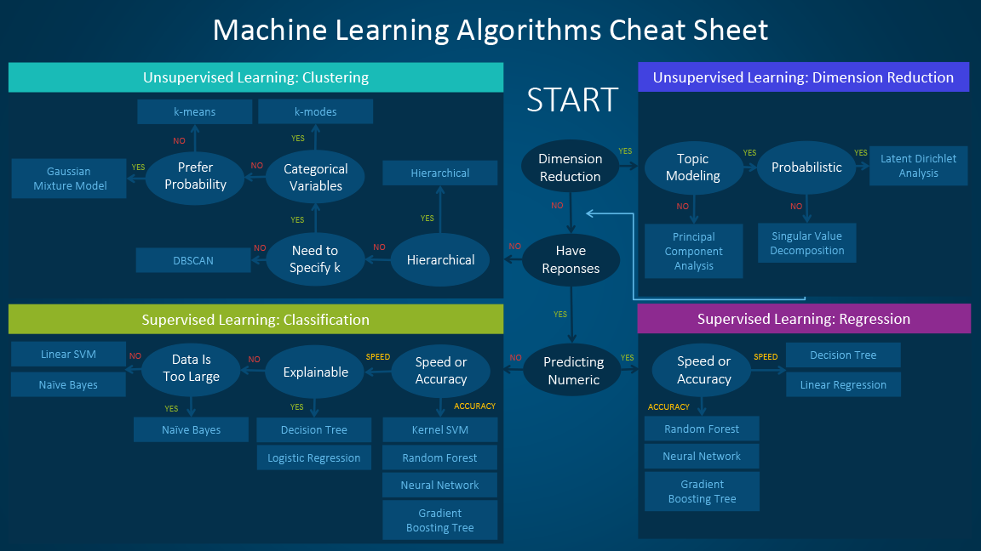

Slide 55
Happy Learning!
Stay Tuned for next exciting sessions on diving deeper into Supervised Learning

